Slide 1
CMPE 258 PROJECT:
BRAIN TUMOR PREDICTION
By: Chint Patel, Dustin Nguyen, Nikhil Khanchandani , Vikranth Jakamukala

Slide 2

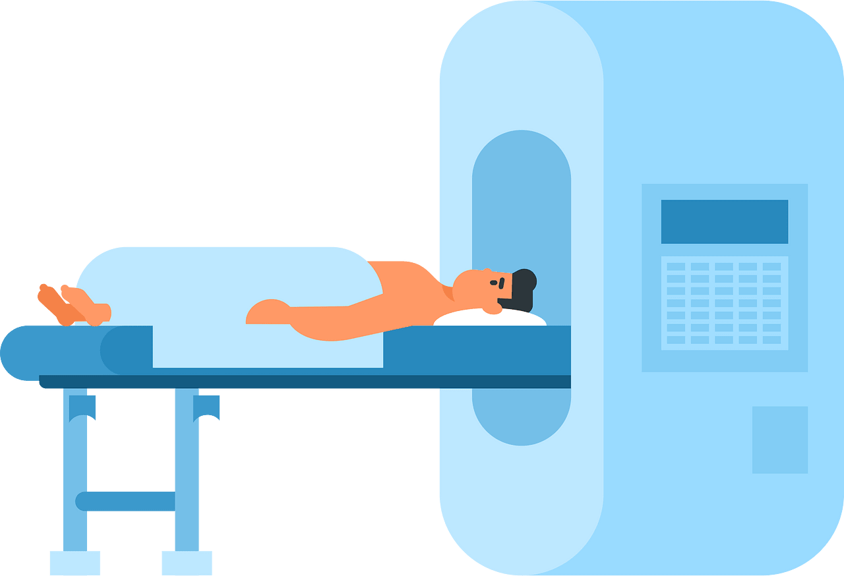
ABSTRACT
What is the constant variable in our lives that is always with us no matter where we go? Time. Time means everything. Whether you are running to your next meeting, trying to rush to the birth of a child, or hoping there is enough time to finish this project. There seems to never be enough time to do everything and anything. With our product, we want to focus on saving time with early detection of brain tumors to properly improve the outcomes and have medical interventions before it is too late. We want to propose the development of an AI-driven detection bot that is capable of identifying the presence of brain tumors in uploaded images. By using advancements in computer vision and deep learning, the bot can analyze medical images such as MRI’s to provide an accurate and a rapid response to allow the patient to respond quickly to treatment.

Slide 3

OBJECTIVE
This project’s goal is to represent a step forward in the application of AI in healthcare, demonstrating the potential use in implementation to provide better clinical decision-making and enhance patient care.

Slide 4
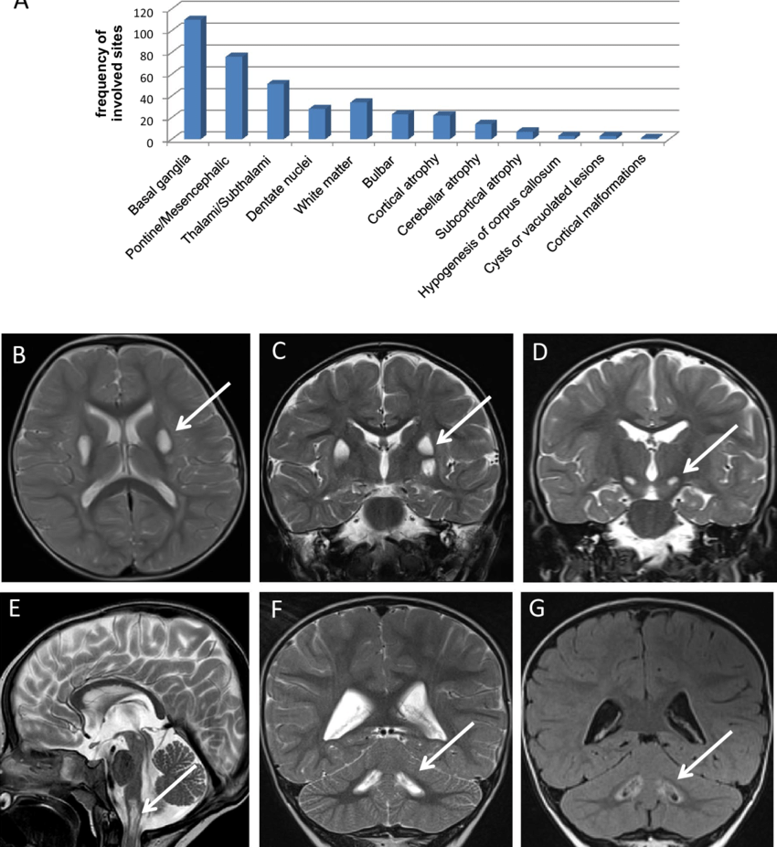
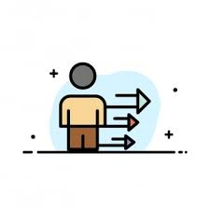
Approach
Our approach is to integrate pre-trained convolutional neural networks (CNNs) to fine tune the strategies ensuring that the model is sensitive enough for the tumor detection. With the streamline diagnostic process, we want to support healthcare professionals, reduce diagnostic delays, human error, and provide a cheaper solution for everyone to be able to afford.

Slide 5
PROBLEM STATEMENT: CHALLENGE
Given the vast complexity of medical imaging and diagnostics we are trying to reduce the time taken from imagining to results. Radiologists take up to 10 days and are often very expensive. We can alleviate this burden by leveraging Machine Learning to scan and understand MRIs to detect tumors. In our case specifically brain tumors. This would reduce the cost of screening by not only reducing manual labor but increasing throughput as computers would be much faster.

Slide 6

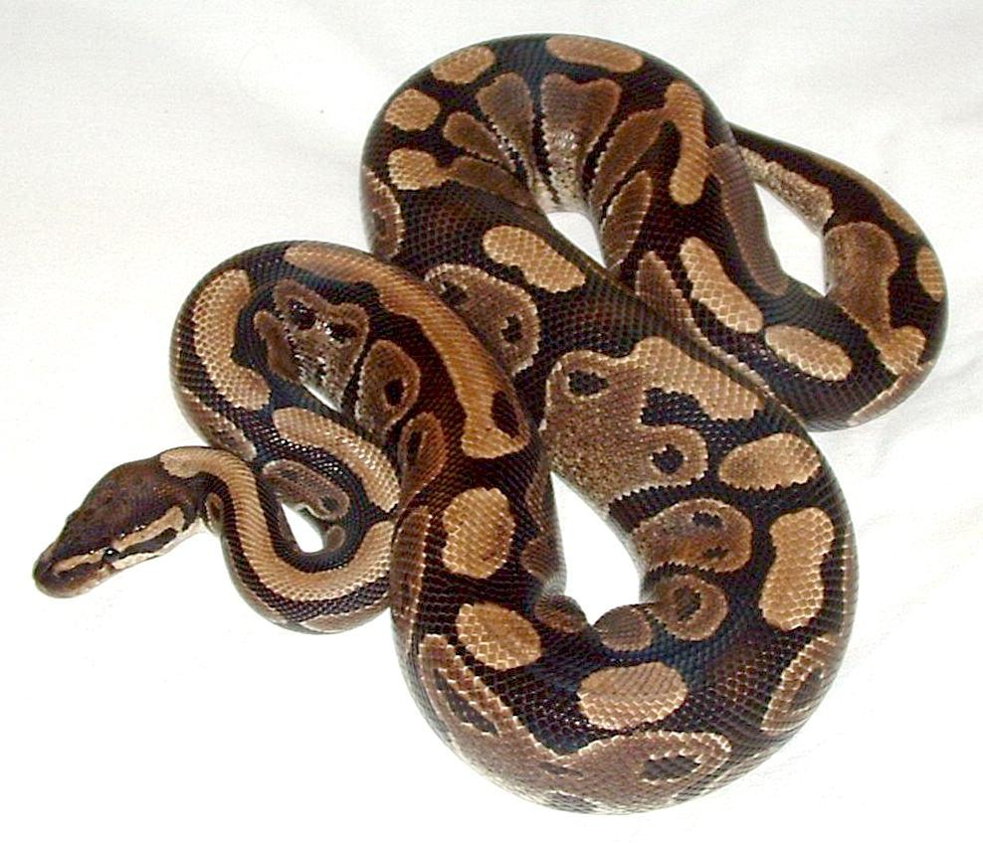



Software Used
Google Colab
Used to collaborate with group to build accurate model
Python
Backend
React
Frontend
Visual Studio
Primary IDE
Material UI
Design the website
Gradio

Slide 7
Future Work
ChatAgent
We want to implement to make it more user friendly for anyone to use
AI Agent to schedule appointment for cancer screening
Be able to be ran locally for privacy and HIPA concerns
Multi-modal Imaging Support

Slide 8
DEMO

